Slide 1
Marketing & Retail Analytics (MRA) Project
PREEJA RAJESH
PGP - DSBA
2020 - 2021

Slide 2
Business Backgrond
Restaurant (café chain) sells a usual mix of Coffee, pastas, beer, and sandwiches. Despite having an incredible spread of menu items, the Café' is still struggling to achieve the sales targets since last 2 Quarters.
Observational data is the Café’s sales data collected for around 12 months. Dataset contains more than one lac of billing record for 5 quarters (from April 2010 to Mar 2011)
Objective
• To understand the sale pattern across different categories with respect to different time frame.
• Conduct market basket analysis to find out the potential of cross selling and up selling

Slide 3
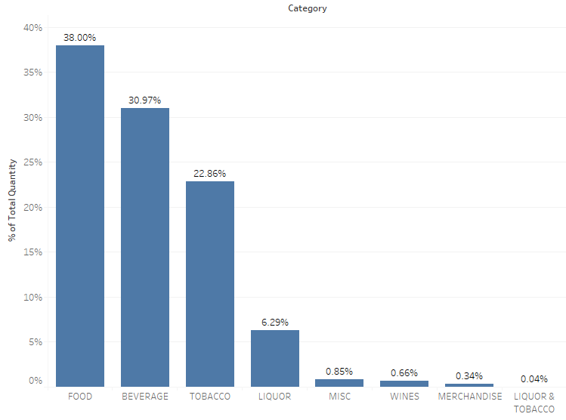
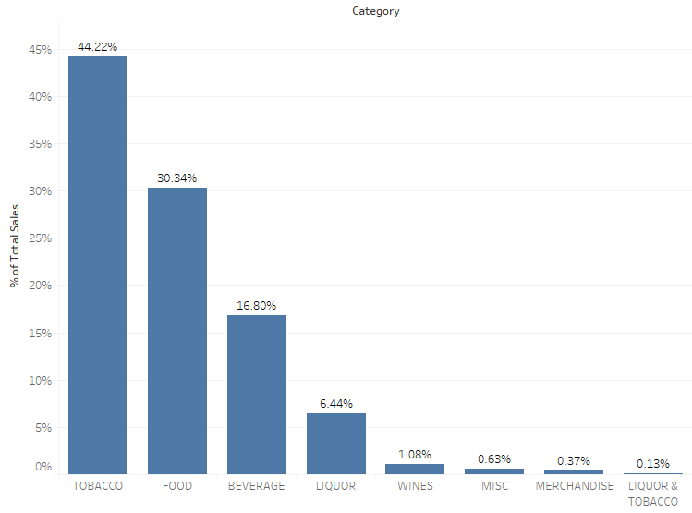
Data Exploration
Quantity contribution of each category
Sales contribution of each category
Food and beverages items sells more but Tobacco has higher contribution towards the total sales.
38% and 30.97% of the total quantity are sold of Food and Beverage respectively.
44% of sales come from Tobacco.
30.34% of sales come from Food.
Ref Link for Tableau: https://public.tableau.com/profile/preeja.rajesh#!/vizhome/Preeja_MRAProject/

Slide 4
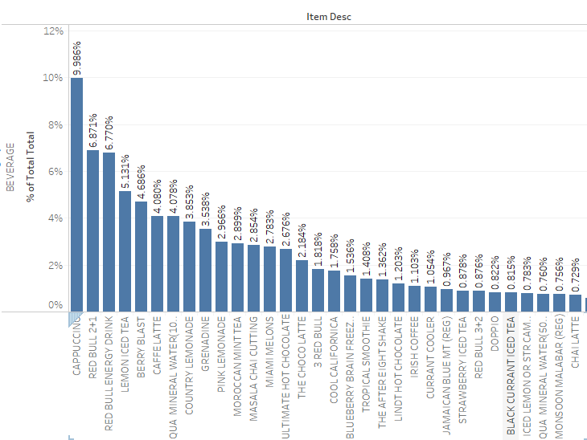
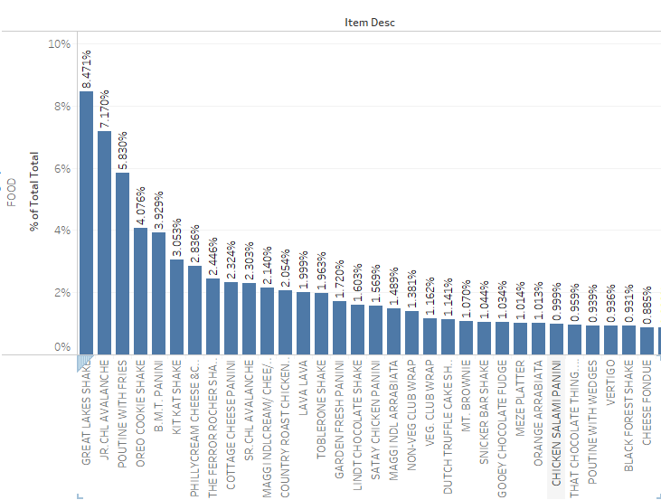
Top items in food and beverage
• Top selling items of beverage are Cappuccino, Red Bull and Lemon Iced Tea.
• Top selling items of Food are Great Lakes Shake, Jr. CHL Avalanche and Poutine with Fries.

Slide 5
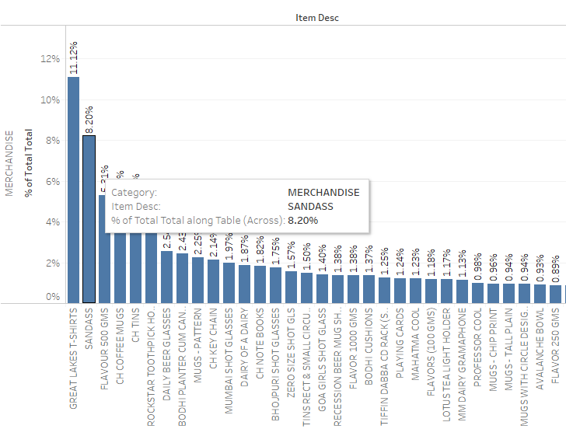
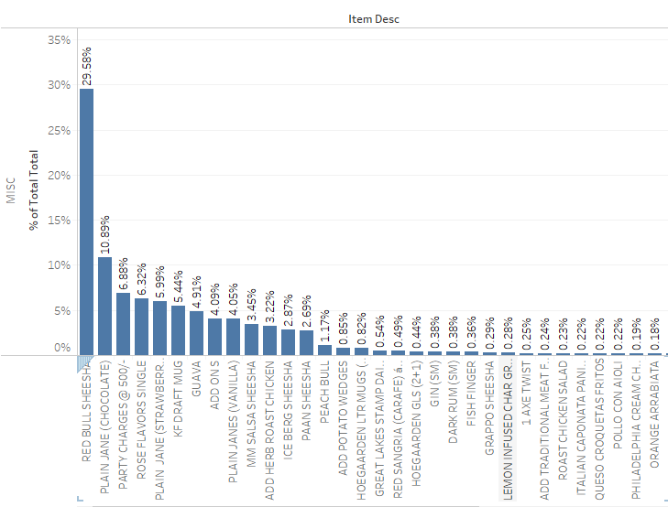
Top items in Merchandise and MISC
• Top selling items of Merchandise are Great Lakes T-shirt, Sandass and Flavour 500gms.
• Top selling items of MISC are Red Bull Sheesha, Plain Jane Chocolate and Party Charges.

Slide 6
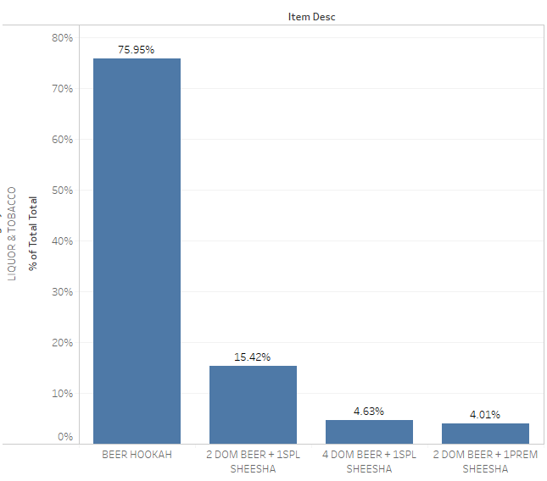
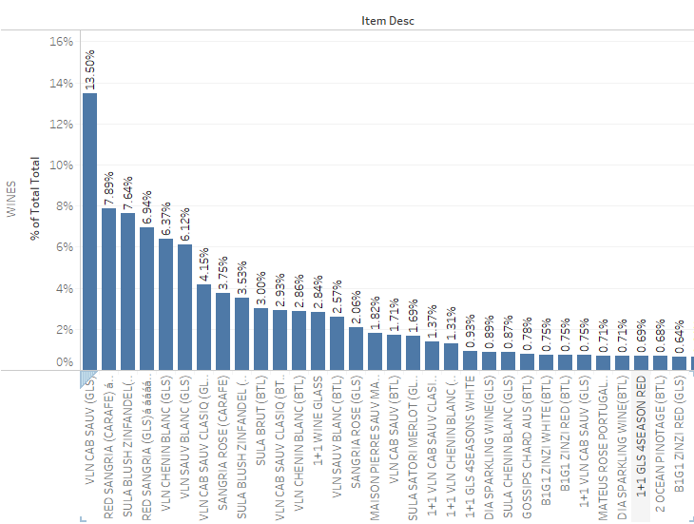
Top items in Liquor with Tobacco and Wines
• Top selling items of Liquor with Tobacco are Beer Hookah and 2 Dom Beer + 1Spl Sheesha.
• Top selling items of Wines are Vln Cab Sau (GLS), Red Sangria and Sula Blush Zinfandel.

Slide 7
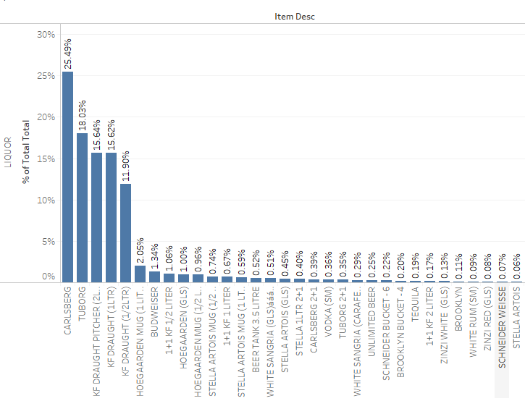
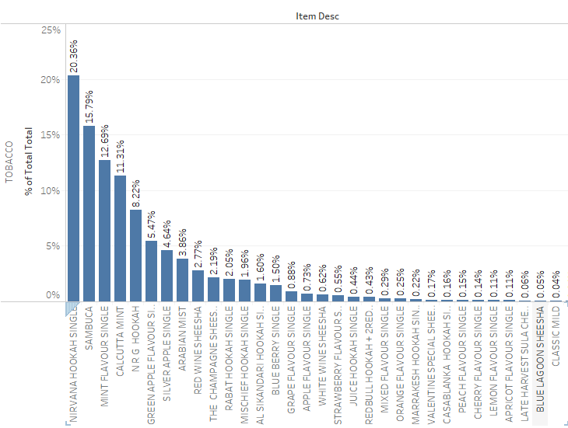
Top items in Liquor and Tobacco
• Top selling items of Liquor are Carlsberg, Tuborg and KF Draught Pitcher.
• Top selling items of Tobacco are Nirvana Hookah Single, Sambuca and Mint Flavour Single.

Slide 8
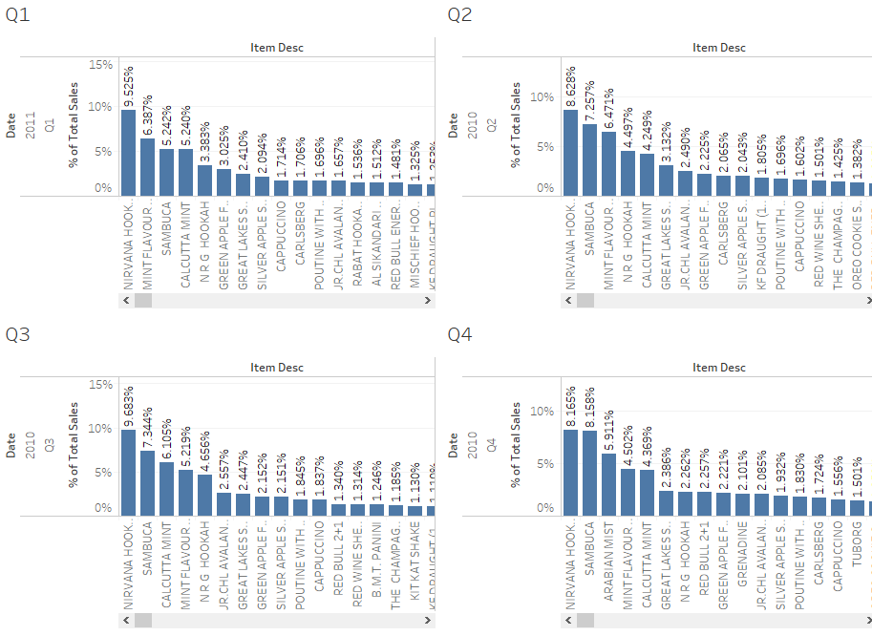
Quarter wise analysis

Slide 9
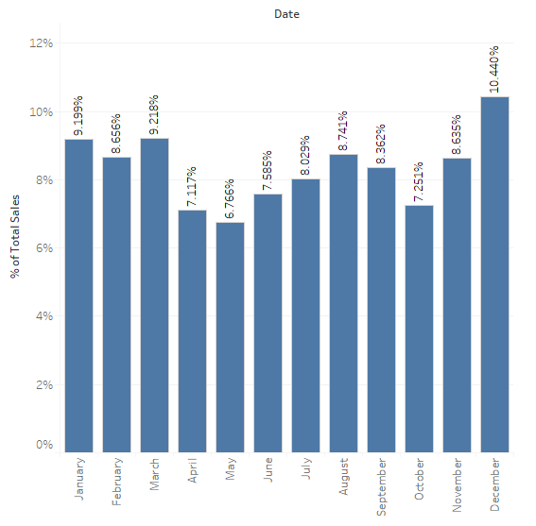
Month wise Sales
As we can see from the graph, the sales of December month is higher as compared to other months. This is due to heavy discounts or schemes for Christmas and New Year.
And also because December is a festive month, so more customers visit the cafe with their family and friends.
The sale after December is gradually falling till summer. So, to retain the sales of the cafe we can give weekly schemes or offers every month after December month to retain its customers.
In July and August the sales are fairly high due to increase in sales in the beverage and liquor category.

Slide 10
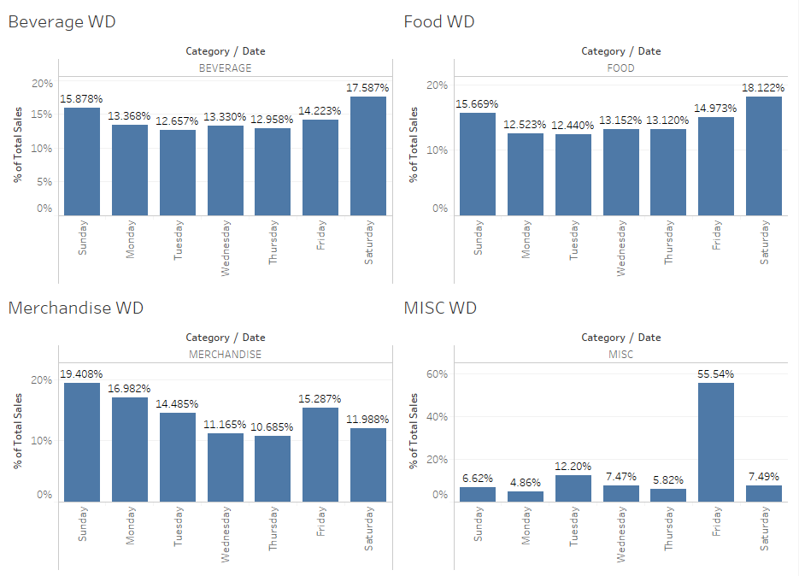
Weekday wise analysis
Weekend sales are more as compared to weekday sales on an average.
For MISC only Friday is the leading day with 56% of sales.

Slide 11
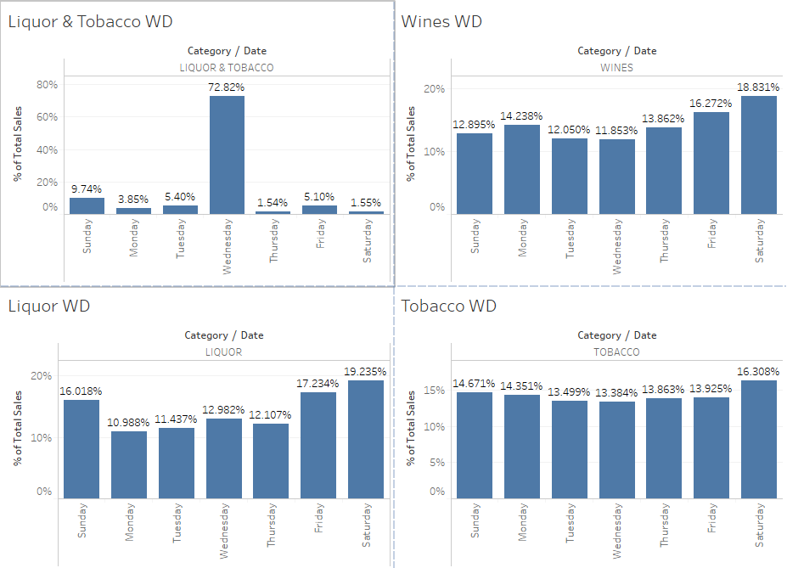
Weekday wise analysis
Weekend sales are more as compared to weekday sales on an average.
For Liquor with Tobacco only Wednesday is the leading day with 73% of sales.

Slide 12
Total sales for each weekday for each category, last three days of the week are pre-dominant in most categories. On calculating the average sales on daily basis we observed that on Saturday the sales are the highest as compared to other days, so we can increase the staffs in the cafe on weekends and reduce the staffs on weekdays to lower the operational cost. Since sales are low on weekdays: Monday-Thursday, the cafe may plan to give special offers on the items or give discount on each categories on a regular basis on the weekdays.
Weekday wise analysis
For example, Monday 20% discount on Beverage, Tuesday 20% discount on Food, Wednesday 30% on Tobacco etc.
Weekend - Fri, Sat, Sun Weekday – Mon, Tue, Wed, Thu
12
November 29, 2020

Slide 13
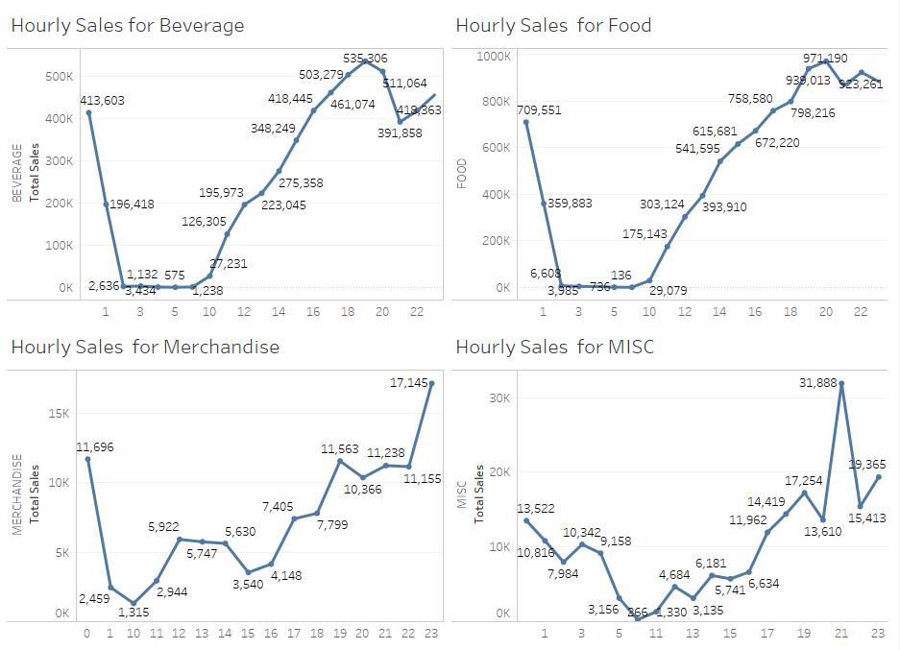
Hourly Sales analysis
We can see from the graph that the sales increases as the day ends, with maximum customers/sales during the nighttime from 8pm-1am.
So the cafe can allot more staffs for the evening shift than morning shift which will help in efficient use of the staffs.

Slide 14
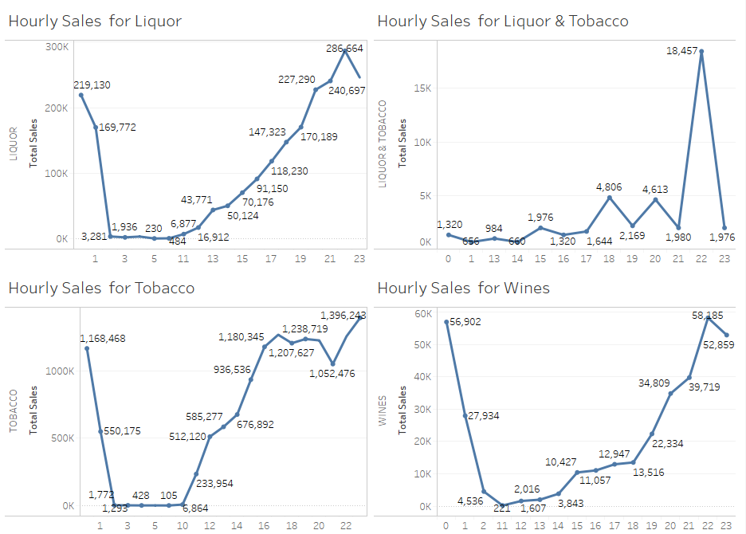
Hourly Sales analysis
Since sales are low during the morning or noon times, the cafe can offer happy hours in the morning or noon to attract customers.
Also, the cafe can start providing breakfast combos or brunch combos to increase the sales in the first half of the day.

Slide 15
Top selling categories according to time
As the day progress people consume more food and beverages items but they also consume tobacco products.
During evening time people consume more beverages items and tobacco products.
During night times people are having along with food items, liquor and tobacco products.

Slide 16
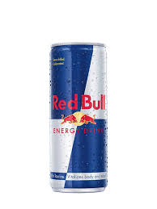
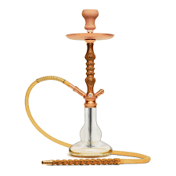
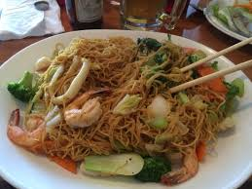
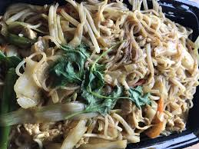
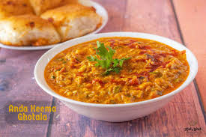
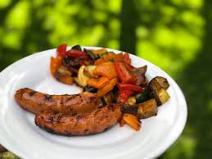
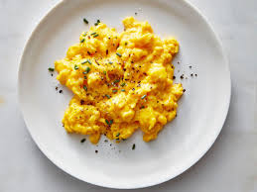
Market Basket Analysis Result (Python)
Associations Identified
Most customer prefer Red bull with N.R.G Hookah since it has more than 71% of confidence and 3332 lift
Most customer prefer Saigon noodles with Chicken since it has more than 54% of confidence and 959 lift
Most customer prefer Kheema ghotala with Buttered Toast since it has more than 46% of confidence and 102 lift
Most customer prefer Grilled Chicken Sausage with Scrambled Egg since it has more than 35% of confidence and 85 lift

Slide 17
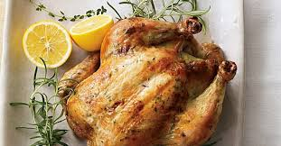
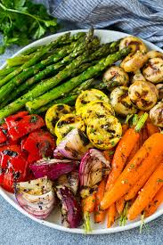
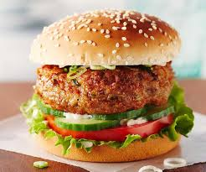
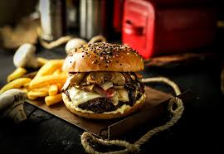
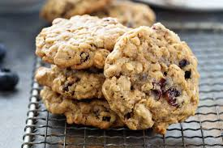
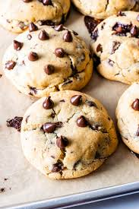
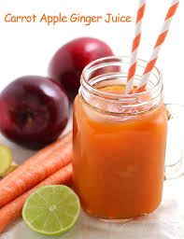
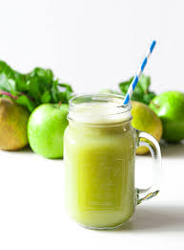
Market Basket Analysis Result (Python)
Associations Identified
The combination of Herb Roast Chicken with Lemon infused char grilled veg will give a lift of 79 and 46% confidence.
The combination of Chicken Burger with OMG Grilled Burger will give a lift of 62 and 14% confidence.
The combination of Oatmeal with Raisin Cookies and Chunky Choco Chip Cookies will give a lift of 57 and 22% confidence.
The combination of Apple + Carrot + Ginger Juice and Apple + Pear + Lime will give a lift of 57 and 14% confidence.

Slide 18
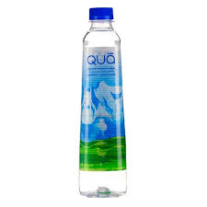
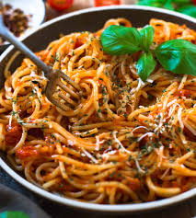
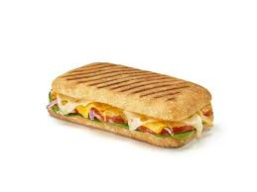
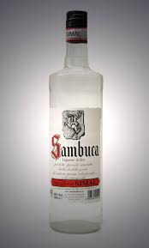
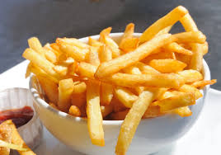
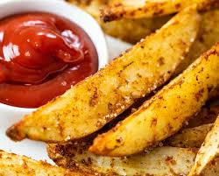
Market Basket Analysis Result (Python)
Associations Identified
The combination of Qua Mineral Water (1000ml) with Maggie Noodles Arrabiata and B.M.T. Panini, Sambuca will give a lift of 52 and 24% confidence.
The combination of French Fries with Potato Wedges will give a lift of 50 and 19% confidence.

Slide 19
Conclusion:
Tobacco category contributes highest to total sales.
For most of categories weekend sales are high as compared to weekday sales.
Sales are high during nighttime where there is hardly any sale during morning time.
Customer buying tobacco products with foods products across the day.
Liquor sales are high during nighttime but hardly any sales in first half of day.
Food items demand are high across the day as compared to other categories.
Merchandise sales are high during daytime as well as night times.
So, after the completion of this analysis report we have drawn the conclusion that Total Sales variable is dependent upon Time duration in a day, Category of the Product, Seasonality (summer/winter) and Specific product brand.

Slide 20
Recommendation:
Give Happy hours offer in liquor category to increase the sales of the liquors during daytime.
Combine the food products with tobacco product with discounted prices.
Combine different food products and sales them at discounted prices.
Operate the store during morning time to increase the sales and include breakfast items.
During weekday sell the products at discounted prices.
Increase the sales of merchandise by providing them at discount price with different food combination or introducing buy 2 and get 1 scheme.
Combine Hookah with food or beverage or liquor items to increase the sales

Slide 21

Thank you

